Slide 1
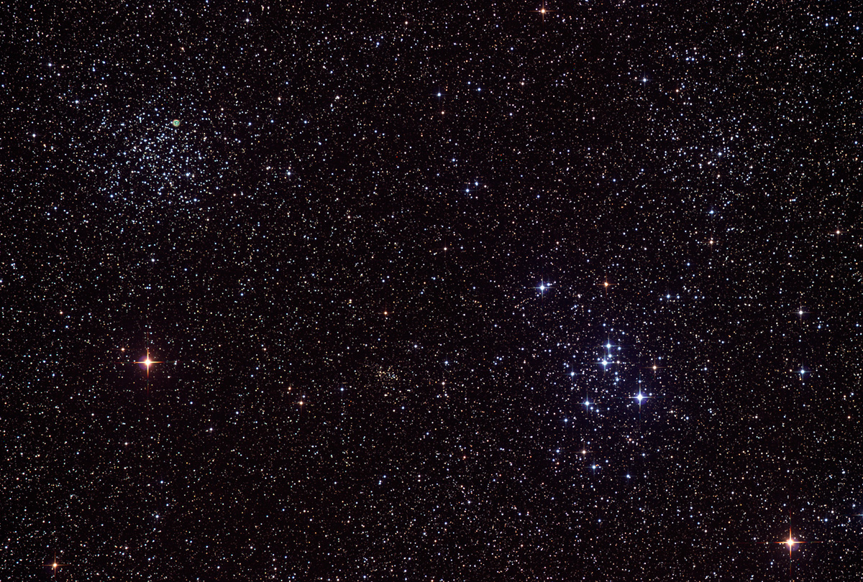

Howard
Astronomical
League
13
July 18, 2013

Slide 2
Company 7 Robbery
Several telescopes, mounts, and binoculars were stolen from Company 7 on July 3rd. Among them:
Astro-Physics 105mm Traveler prototype
Astro-Physics 130 EDF, S/N 130EDF01
TeleVue TV85 (Brass), S/N B0001
TeleVue NP101, S/N 1001, autographed by Al Nagler “Marty’s Lens”
Keep an eye out for these scopes and notify police if you see them at star parties or on Astromart, Craig’s List, Cloudy Nights, etc.
Notes:
From: Martin Cohen <martin@company7.com>
To: Martin Cohen <martin@company7.com>
Sent: Thursday, July 18, 2013 5:08 PM
Subject: Company Seven Showroom Burglary of 3 July
Box 2587
Montpelier, Maryland 20709-2587
(301) 953-2000
18 July 2013
Please pardon the bulk nature of this E-Mail, but it is the best way I know to circulate our message.
At 6:05 am on Wednesday 3 July Company Seven's showroom was burglarized. Before Police arrived in response to the alarm several telescopes, mounts, and a number of binoculars were stolen. There was damage to some other telescopes and to the premises. I have really been saddened by this, several of these instruments lost have fond memories for me and for visitors to C7 – and even when we put up similar replacements on display the showroom can never be quite the same. I have no idea what the prospects are of recovery of these telescopes, I can only hope these guys do this again elsewhere until they mess up and may be caught.
I returned from overseas travel on Monday 15 July to deal with this, and since then we are instituting additional measures to harden the showroom against such attacks. I do not intend to put replacement telescopes or binoculars on display until all hardening measures are in place.
Please make note of the telescopes and the mounts damaged/lost/stolen, and feel free to post or circulate this information and be aware if you scour any auction sites (Craig's List, Astromart, etc.). Also note the stolen telescopes were not furnished with eyepieces or other common accessories, and some without even a 2" diagonal. Most telescopes stolen lack their carrying case, while the TeleVue 85 was taken with its carrying bag complete with registration card. The tripods and telescopes may have been damaged as they were hastily removed from the showroom.
1. Astro-Physics Telescope, Refractor, 105mm, Apochromat, Model "Traveler", 4.14" f/6, one of the two prototypes (NO SERIAL NUMBER), acquired 8/30/91 (STOLEN)
2. Astro-Physics Telescope, Refractor, Model "130 EDF", S/N 130EDF01 (the first production 130 EDF telescope), Apochromat 5.1 inch f/6 130mm EDF, acquired 2/27/1995 (STOLEN)
3. Astro-Physics German Equatorial Mount, Model 400QMD German Equatorial Mount Head SN400002C includes: Encoder Set, NGC-MAX CPU, 8" Dovetail Saddle, 'V' Series, Model AWT Wood Field Tripod, Adjustable Height, with Pier Adapter for 400/600 Mounts, 6 lb. Stainless Steel Counterweight, 9 lb. Stainless Steel Counterweight, Slide Bar, 8" long, V series, 8x50 Finder telescope with Quick Release Bracket for 8x50 Finder. (STOLEN)
4. TeleVue Telescope, Refractor, 85mm, Refractor Brass, Model TeleVue 85 (Brass), S/N B0001 complete with carrying bag, 2 inch diagonal. Acquired 1/6/1999. (STOLEN)
This is shown in several photos of our showroom, and featured in our on-line description of these telescopes at <http://www.company7.com/televue/telescopes/tv85.html>
5. TeleVue Telescope, Refractor, 101mm, Model NP101, PN NPC-4054 Ivory and Black Apo, S/N 1001 (autographed by Al 'Marty's Lens') on display since 8/9/01. (STOLEN)
The telescope was equipped with the Starbeam sight. The set is also featured in our on-line description of these telescopes at <http://www.company7.com/televue/telescopes/tvnp101_2001.html>
6. TeleVue Telescope, Refractor, Renaissance 101mm, Brass/Blk, Refractor, Model RB4-4054, S/N 1037, Brass on display since 12/16/99. (STOLEN)
This telescope is shown in several photos of our showroom, and also features in our on-line description of these telescopes at <http://www.company7.com/televue/telescopes/tv101br.html>
7. TeleVue Wood and Brass Gibraltar Mount (older style larger Gibraltar mount with teak wood tripod with solid brass top and with brass plated trim), supporting the 101 Renaissance brass 4" Apo telescope. Acquired 12/16/1999 (STOLEN)
8. TeleVue Wood and Brass Gibraltar Mount (older style larger Gibraltar mount ash wood tripod with black finished cast aluminum and trim), supporting NP101. Acquired 9/14/1994 (STOLEN)
9. TeleVue Wood and Brass Panoramic Mount (wood tripod with rare solid brass top and brass trim), supporting the TeleVue 85. Acquired 1/6/1999. Closest modern replacement cost $765.00 (STOLEN)
10. There were numerous 20mm up to 50mm aperture Carl Zeiss and Leica binoculars, and some Fujinon 50mm binoculars stolen.
If any information comes up or suspicions are aroused then since the case is being handled by Prince George's County Police (Case #13-184-0366), please contact Detective Shapiro of their local Beltsville precinct in charge of this. That is PGPD District VI, 4321 Sellman Road, Beltsville, MD 20705-2543, telephone (301) 937-0910
Sincerely,
Martin Cohen
Company Seven

Slide 3
HAL Librarian Wanted
Jim Nickel donated about 130 astronomy books to HAL in his will
We need someone with about 10 linear feet of bookshelf space to be the club librarian

Slide 4
Stumper Question

Slide 5
What is the only moon in the solar system that is not tidally locked to its planet?

Slide 6
What is the only moon in the solar system that is not tidally locked to its planet?
Saturn’s moon Hyperion, which is not round, and tumbles due to the influence of Titan
Notes:
A. Hyperion,moon of Saturn (it tumbles erratically, due to Titan's influence) Here is what Wikipedia says about Hyperion:
The Voyager 2 images and subsequent ground based photometry indicate that Hyperion's rotation is chaotic, that is, its axis of rotation wobbles so much that its orientation in space is unpredictable. Hyperion is the only moon in the Solar System known to rotate chaotically. It is also the only regular planetary natural satellite in the Solar System known not to be tidally locked.
Hyperion is unique among the large moons in that it is very irregularly shaped, has a fairly eccentric orbit, and is near a much larger moon, Titan. These factors combine to restrict the set of conditions under which a stable rotation is possible. The 3:4 orbital resonance between Titan and Hyperion may also make a chaotic rotation more likely.

Slide 7
Upcoming club activities

Slide 8
Star Parties and public outreach!
August 3rd – Members only Star Party
August 10th – Public Star Party
August 17th – Solar Max at RNC,
1-4 pm

Slide 9
Member’s astrophotos and sketches

Slide 10
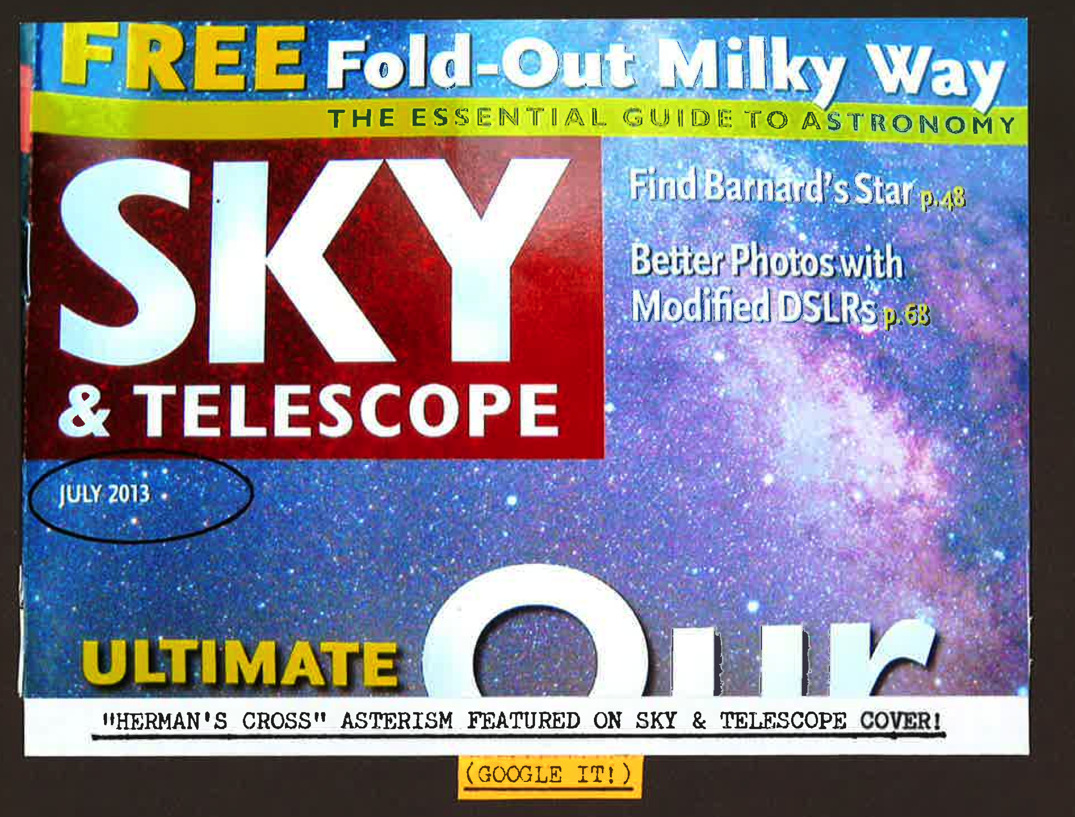
Herman Heyn

Slide 11
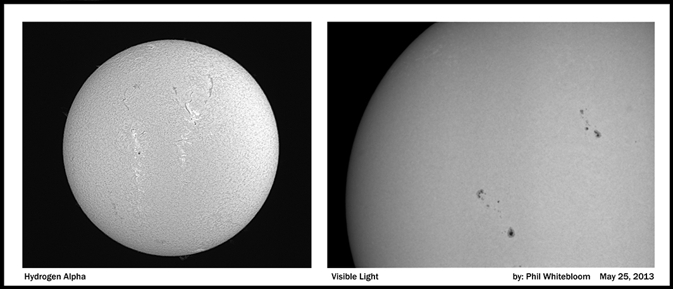
Phil Whitebloom

Slide 12
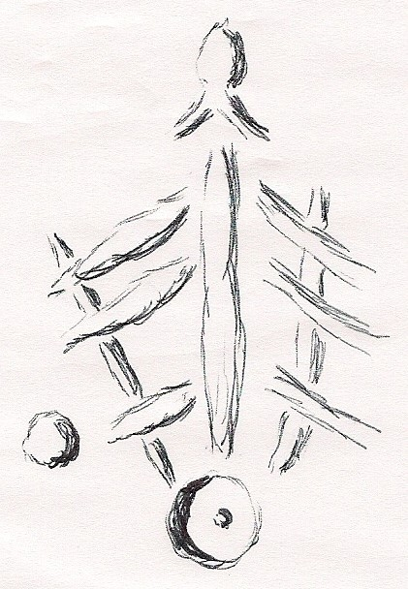
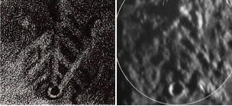
Bob Prokop

Slide 13
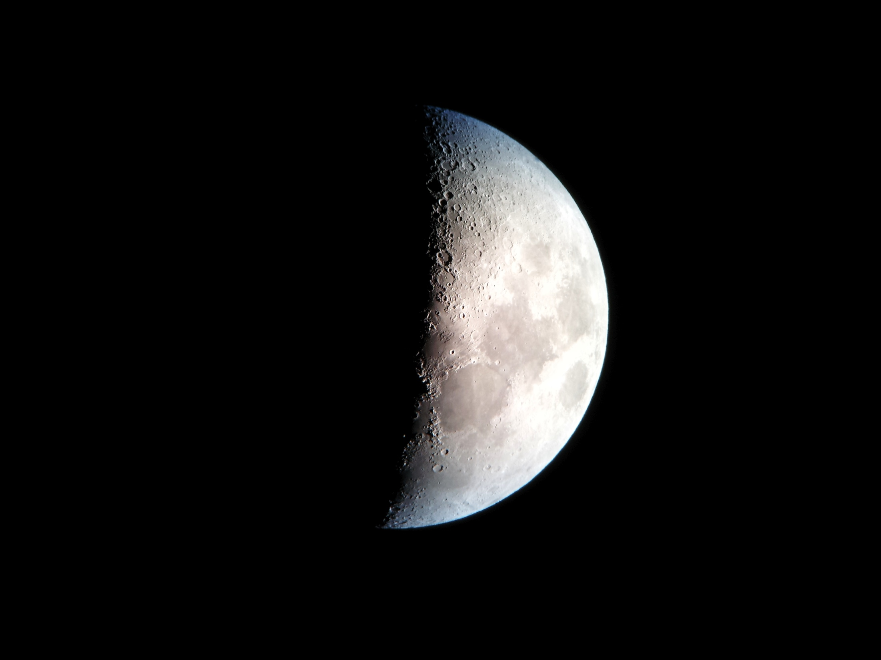
David Stein

Slide 14
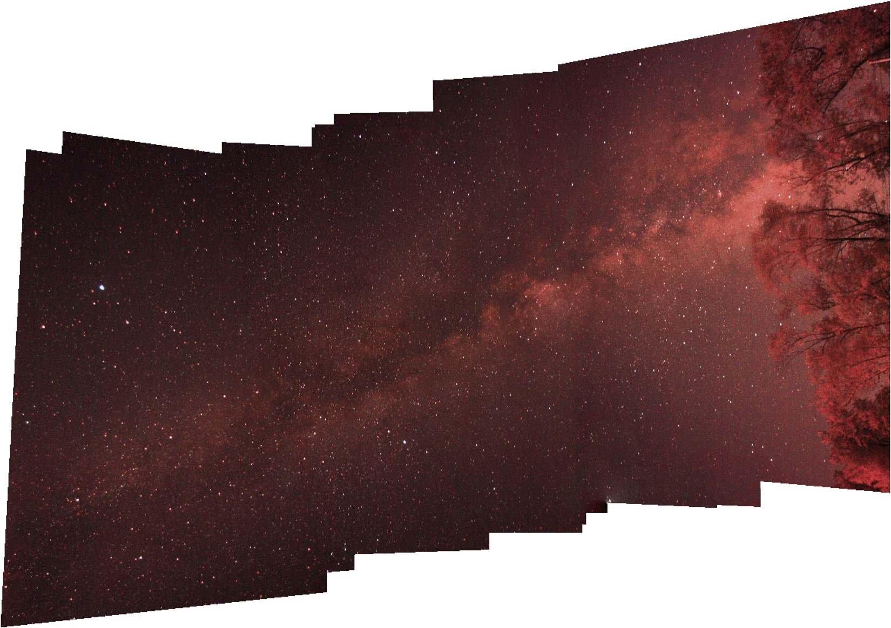
Chris Miskiewicz

Slide 15
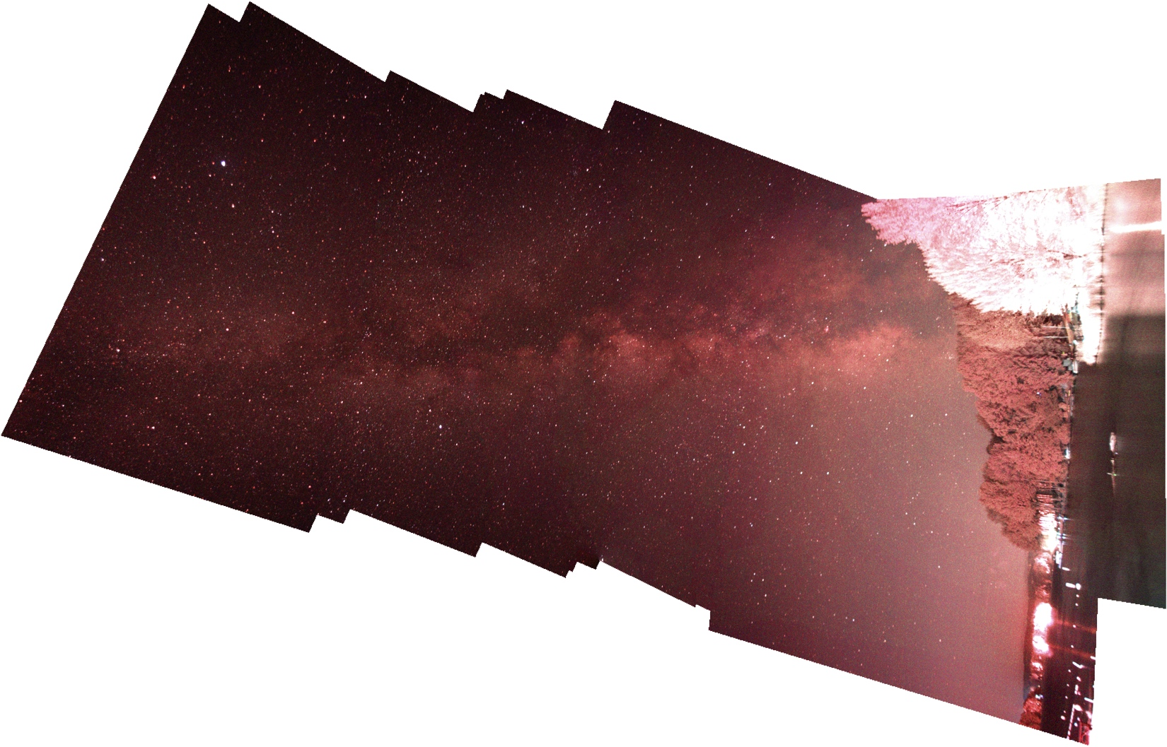
Chris Miskiewicz

Slide 16
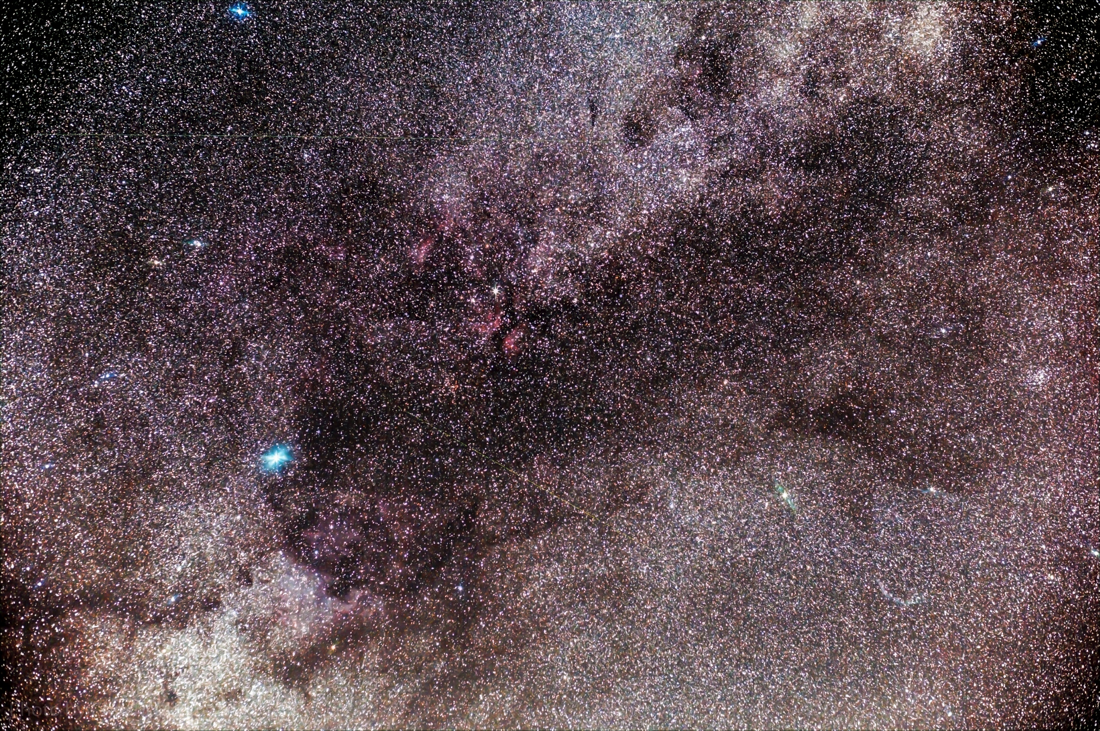
Chris McGrath

Slide 17
Observing meteor showers
Gene Handler

Slide 18
So you wanna attend a regional star party?
(Continued)

Slide 19
Texas Star Party
Seven nights, typically in Spring (April or May; May 5-12, 2013)
Held at Prude Guest Ranch, Fort Davis, Texas, at > 5,000 feet, in the middle of nowhere. Prude Guest Ranch is awesome facility
Probably the darkest skies you’ll ever see
Hundreds of attendees – lots of big scopes (including 36” dob)
AC Electrical all over the field
Surprisingly reasonable registration (~$60)
Don’t bother camping, get a spot in the bunkhouse ($45/day, includes meals!) Food is awesome and plentiful
Dew is almost never a problem, but bring ChapStick and a tarp (dust!)
Quite a few vendors, good raffle, and good speakers
Real bathrooms and showers, bunkhouses have heat and A/C
McDonald Observatory is awesome and worth a tour, and Fort Davis is a charming little town, with a few decent restaurants, Fort Davis is a neat piece of history, and Davis Mountains State Park is nearby
Weak and spotty cell service, but WiFi available on the observing field

Slide 20
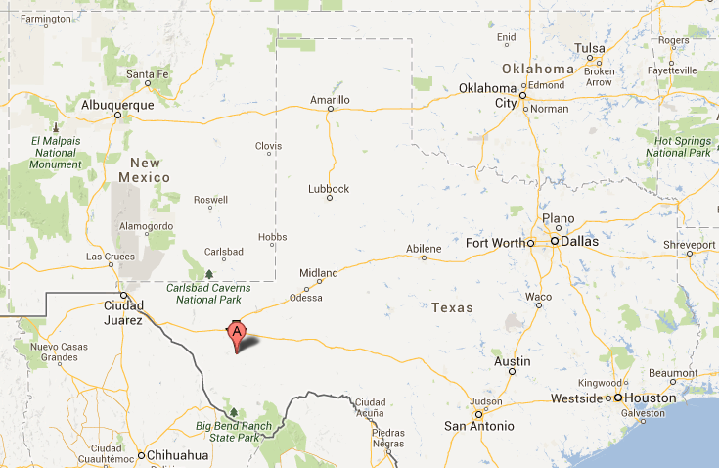
Texas Star Party
Map and pictures

Slide 21
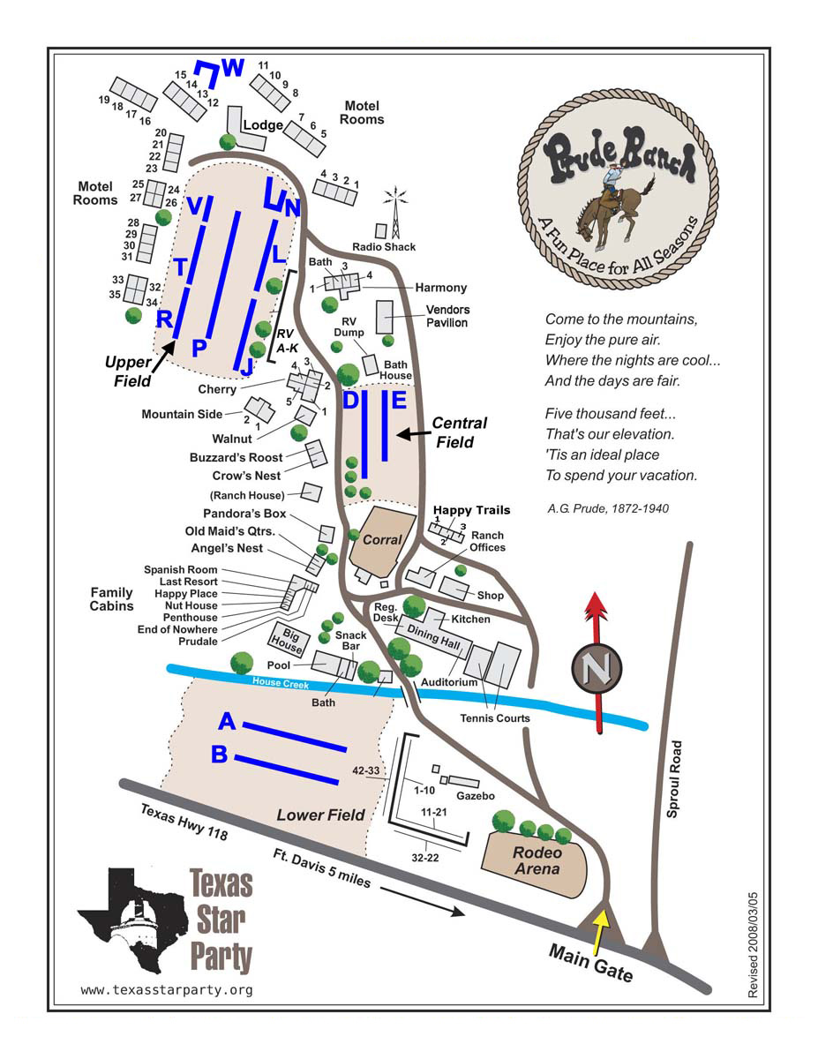

Slide 22
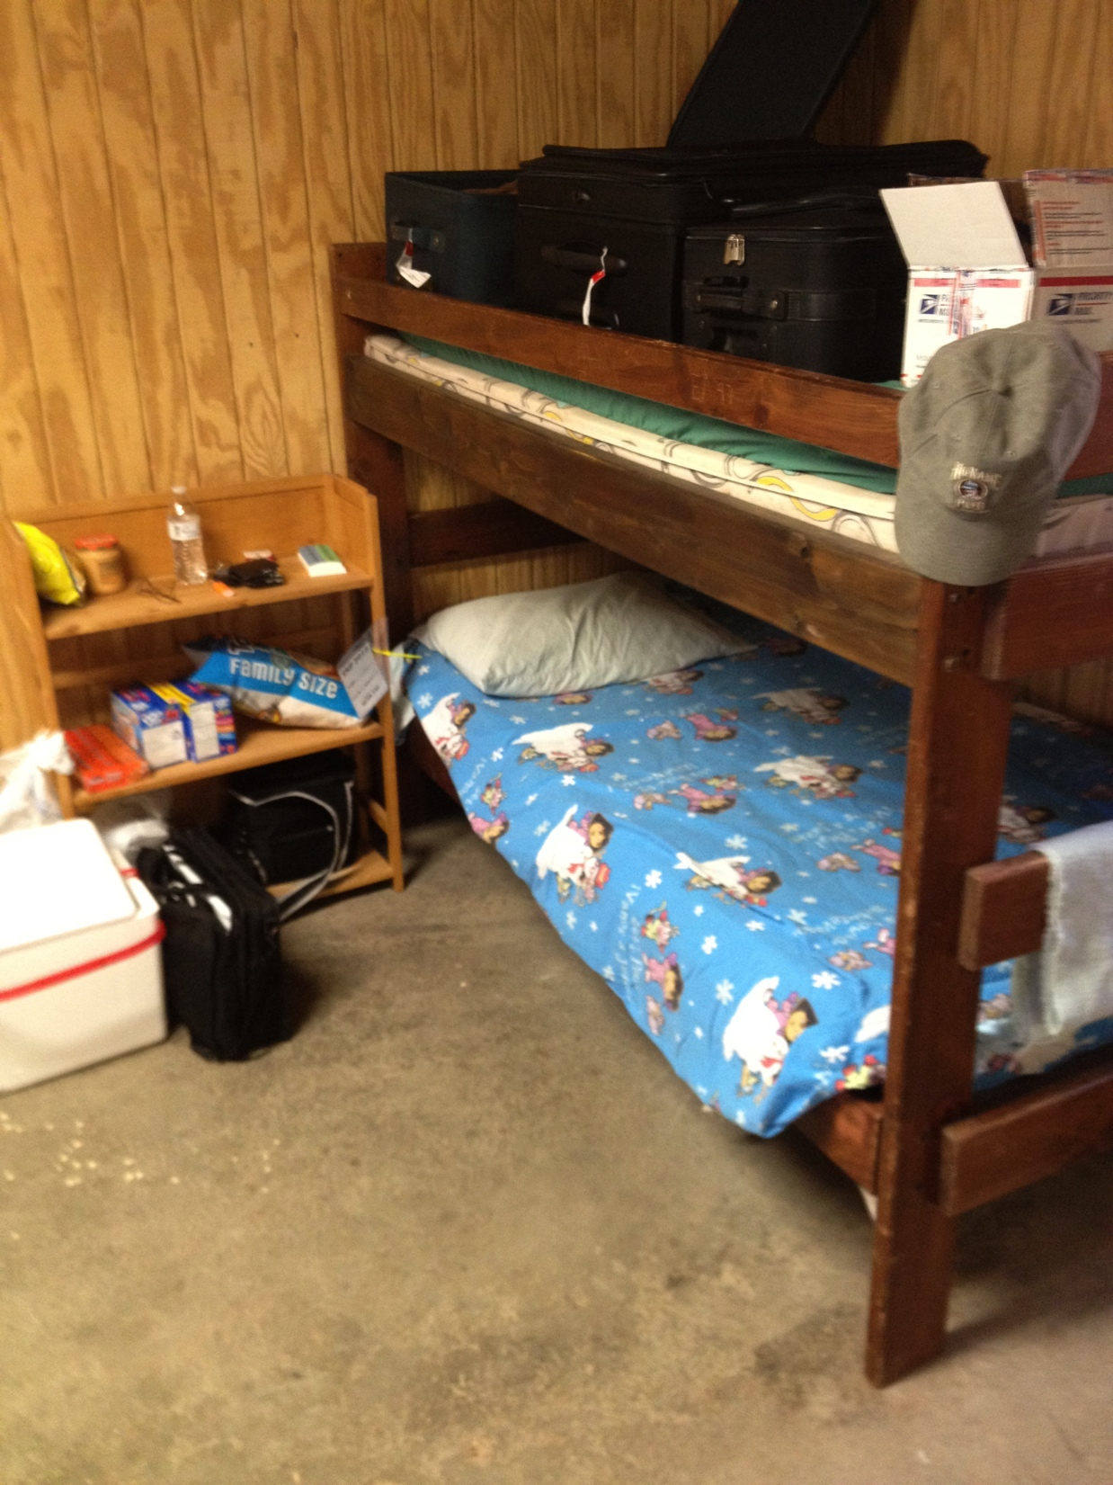
Texas Star Party

Slide 23
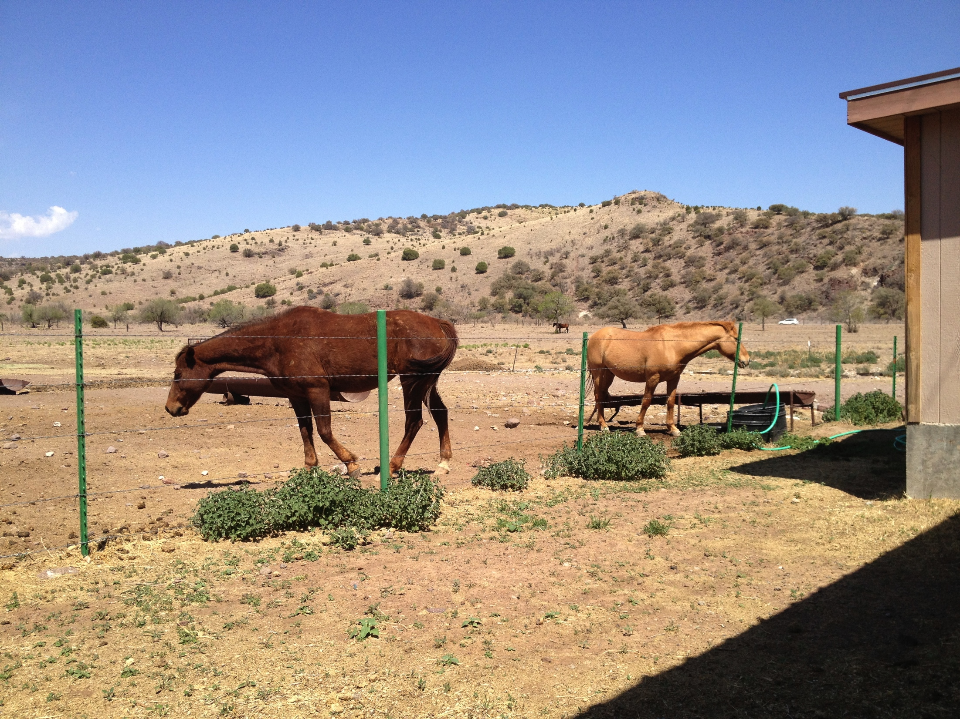
Texas Star Party

Slide 24
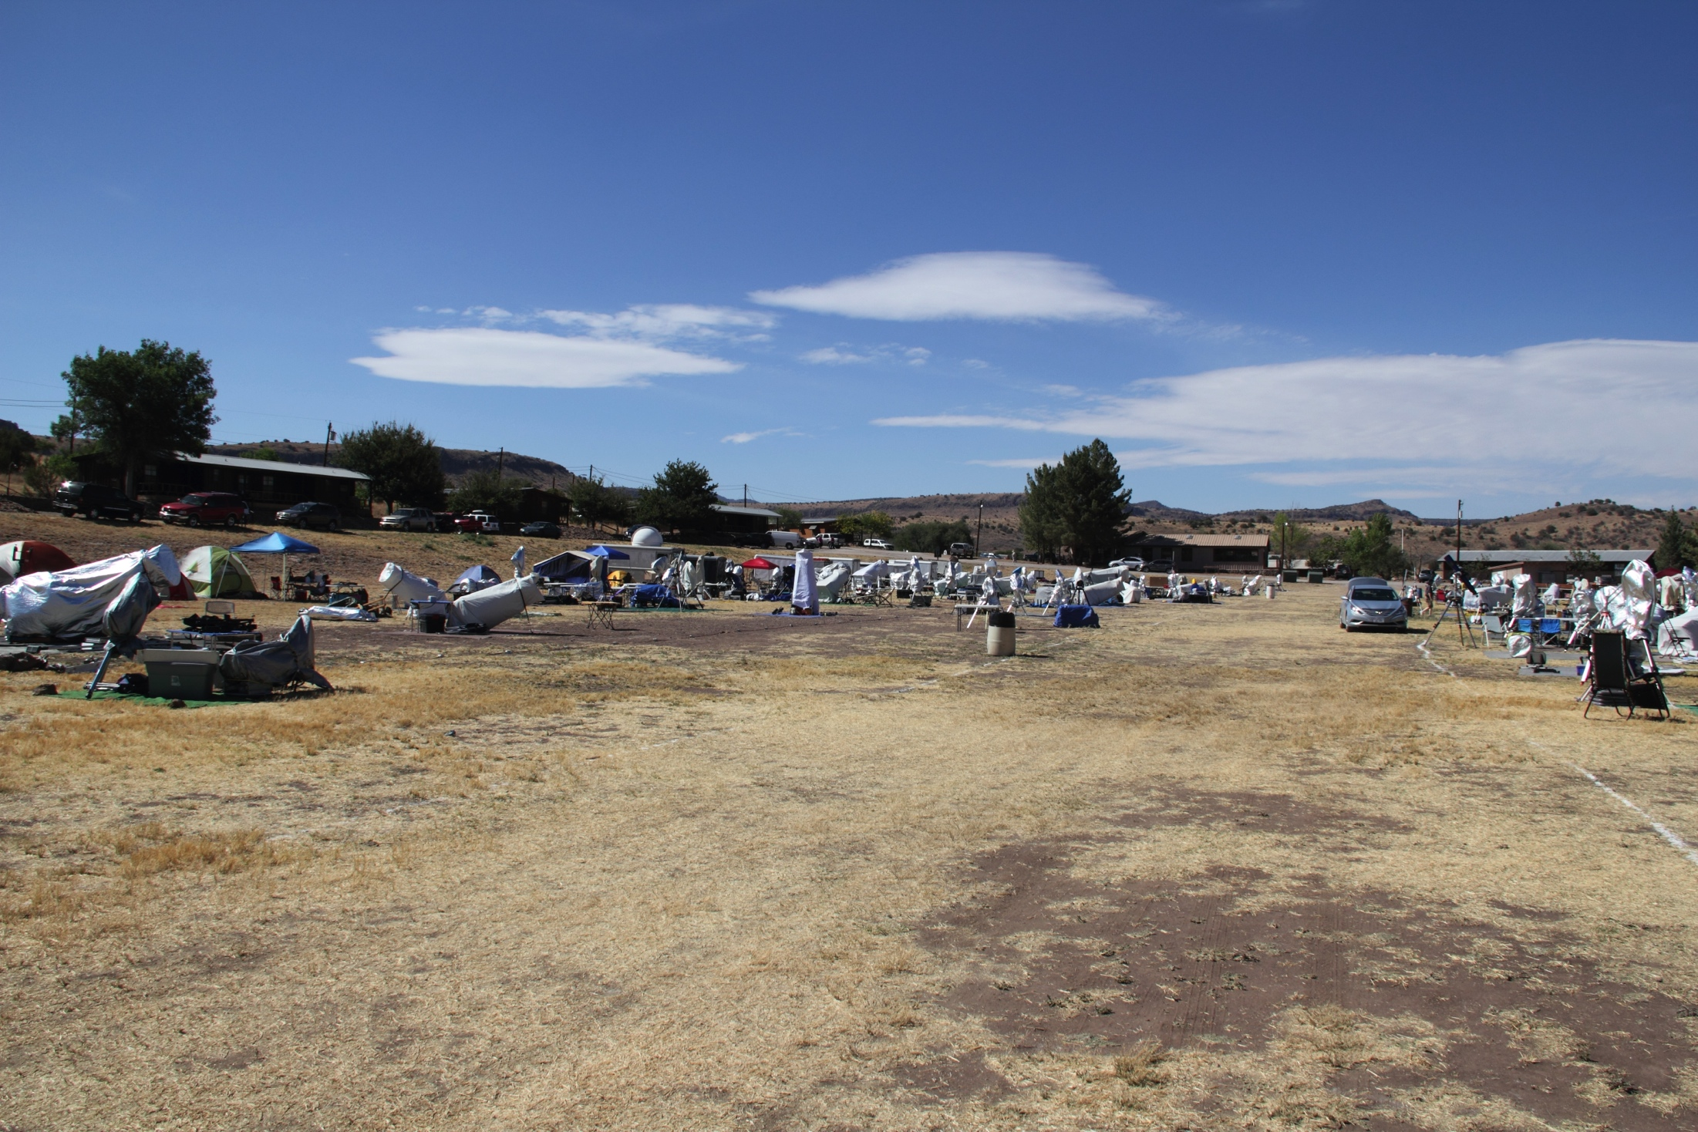
Texas Star Party
Field and scope pictures

Slide 25
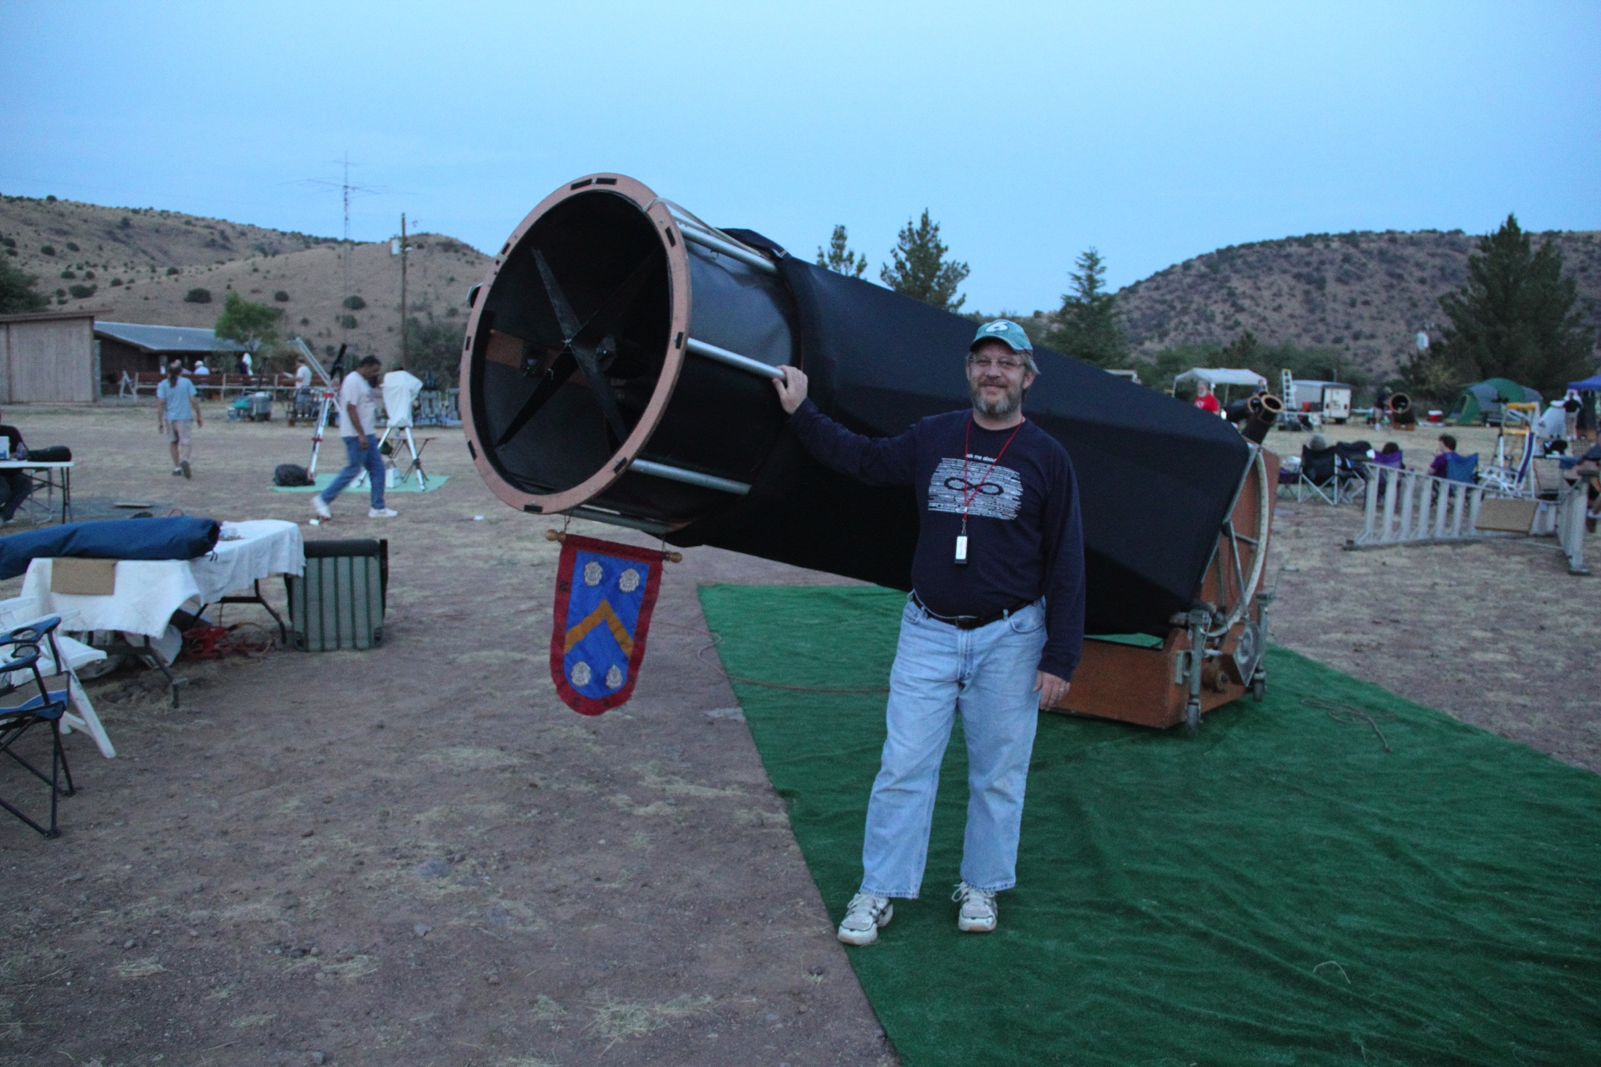
Texas Star Party
Field and scope pictures

Slide 26
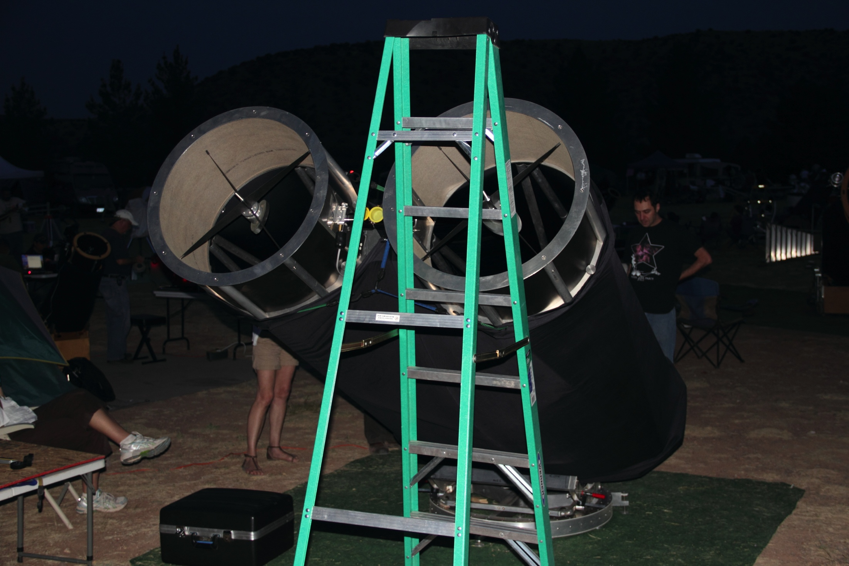
Texas Star Party
Field and scope pictures

Slide 27
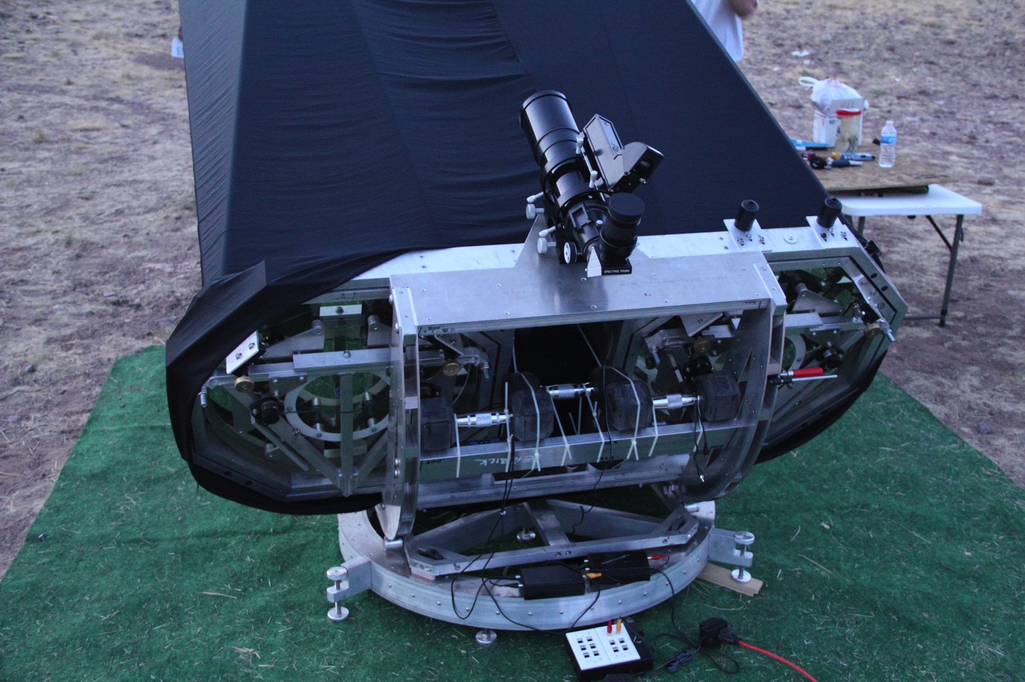
Texas Star Party
Field and scope pictures

Slide 28
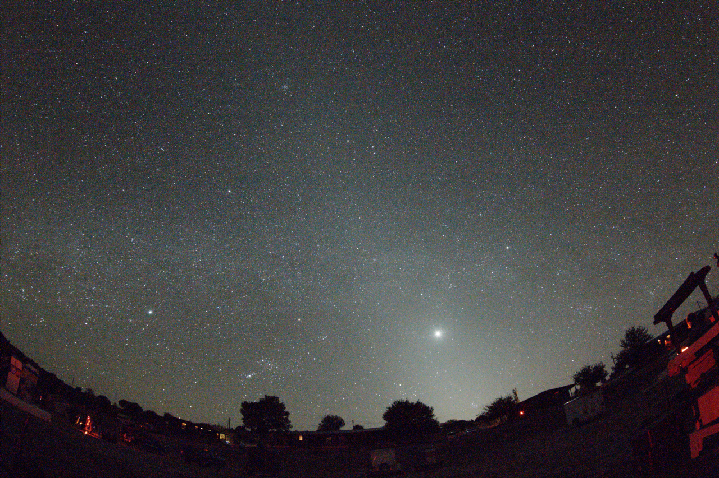
Field and scope pictures

Slide 29
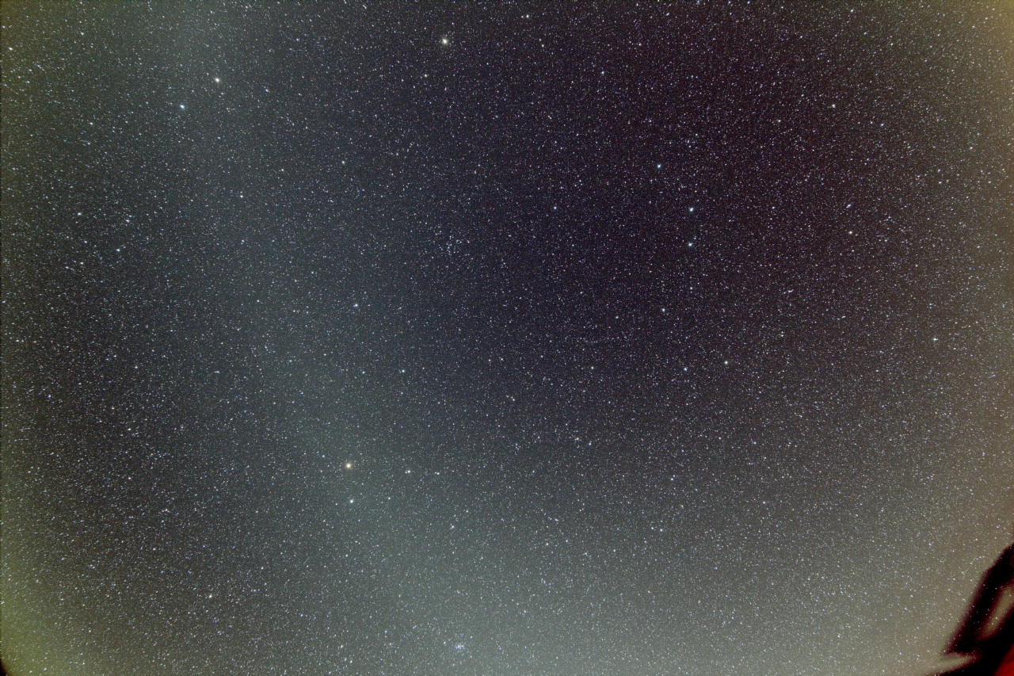

Slide 30
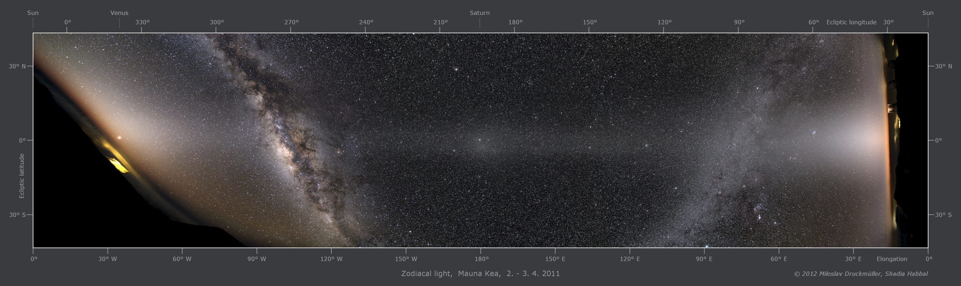
Miloslav Druckmüller
http://apod.nasa.gov/apod/ap120405.html

Slide 31
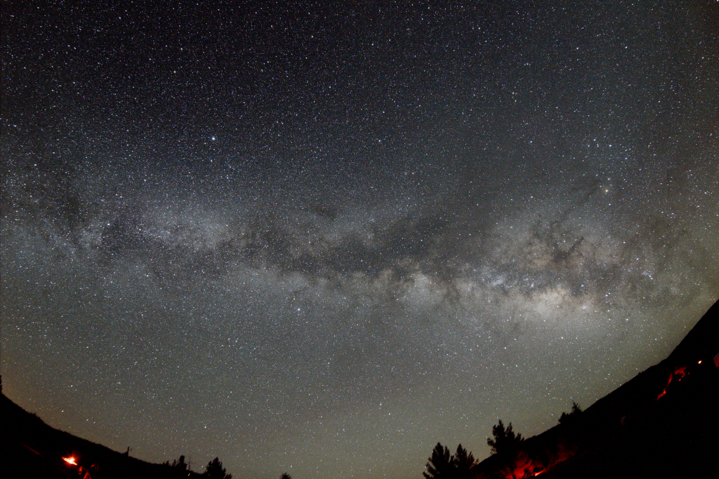

Slide 32
Texas Star Party
Night sky time-lapse
Notes:
Break out for your time lapses from last year

Slide 33
Thank You!
Next month’s meeting is on Thursday,
August 15th, 2013
7:30 PM
Guest speakers:
I have no idea yet

